Slide 1
Lifelong learning
Digital upskilling and reskilling for change
Annita Fjuk, PhD Head of academic collaboration & continous learning DigitalNorway
Notes:
It’s not only about AGE, but the interests, passion and capability to learn in a changing business. Skills acquired in initial education become outdated more rapidly as technological breakthroughs speed up.

Slide 2
1
Sharing of data across actors and sectors is driving innovation and value creation in a data-driven economy.
To realize the potential, lifelong learning for a dynamic and rapidly changing working life is a crucial driving force.
- Liv Dingsør, CEO DigitalNorway
SHARING OF DATA
LIFELONG LEARNING
Notes:
The digital and data-economy is fundamentally transforming the way we work. This will have a profound effect on the tasks we perform and the skills that are required.
It’s not only about technological expertise, but skills such as problem-solving and communication, curiosity, adaptability and emotional agility are becoming as important. These qualities ensure greater resilience and success in the face of a changing work and social environment. This provides a rich environment and culture for lifelong learning.

Slide 3
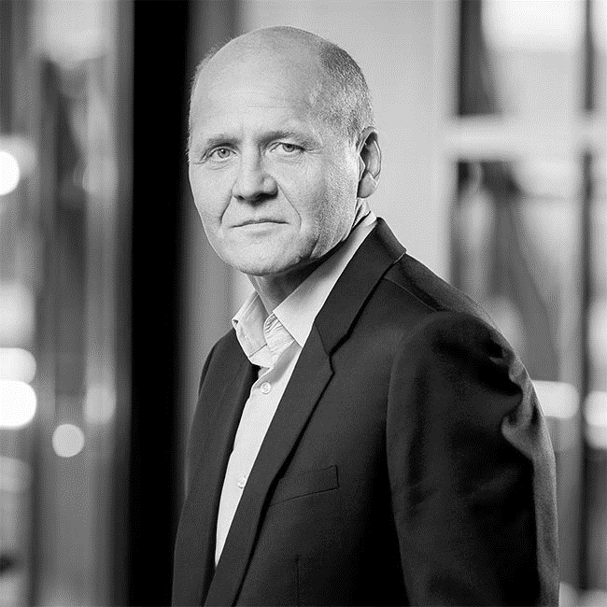
The society is fundamentally changed by digitalization and (…) we have seen important advances in artificial intelligence, the Internet of Things and the road to 5G. By equipping our employees with relevant expertise and skills to face a digital future, we turn what could have been a challenge into an opportunity to work in new ways.
- Sigve Brekke, President and CEO Telenor Group
TURNING CHALLENGES INTO OPPTURNITIES Up- and reskilling of employees as a competitive
advantage going forward in the new economy
Notes:
Before I joined DigitalNorway, I worked in Telenor Group – one of the biggest telcos in the word and with many years of sucess nationally and internationally. I worked with the company’s transfromation journey, and with a particular focus on upsskilling/reskilling of mgmt teams and experts..
As a consequence of a dynamic business environment driven by the new economy, Telenor and other large corporates have developed and offered a number of up-skilling/re-skilling initiatives across the organisation.

Slide 4
Creating a culture for learning, new ways of working and innovation
CONTEXT
DECISION-MAKING & CULTURAL ARCHITECTS
BEHAVIOUR
ROLE-MODELLING
VALUES
BELIEFS MINDSET
AWARENESS-BUILDING
Source: Telenor Group, 2018/2019
Notes:
Telenor represents a huge tanker ship with established mindsets, values and beliefs based on several decades of growth and success – nationally and internationally. How do they moved-around to start building a culture for learning, new ways of working and innovation? There are several approaches for this:
Change from the top, with new governance, KPIs, and even new mgm-teams, or to
Change mindset, but this it’s hard and will often implicate down-sizing and recruiting of new people. Bute the existing culture will often still be there, and “eat the strategy for breakfast”
The approach was to start awareness building. This implicate a number of training- and upskilling initiatives
Organise for Courses based on a competence gap identified 40 hours training- Every employee throughout the organisations was motivated to use at least 40 hours on upskilling.
New ways of working – based on increased experimentation, ideation and creativity.
The assumption behind this approach, was to change BEHAVIOUR and create role models. Then the others will follow – both the context and the mindset. And the company is slowly moving to such a culture. Leaders needs to cultural architects.

Slide 5
DigitalNorway is driving lifelong learning for all through a coordinated effort across actors and eco-systems We don’t have the same capacity as the corporates in terms of economical resources, time and flexibility. This is critical for our innovation capabilities and future competitive advantage and growth. - CEO of Norwegian SME
SMEs
Corporates
Authorities
Educational institutions
Notes:
However, the majority of Norwegian companies – the small and the medium-sized ones (SMEs) - don’t have the same capacity in terms of economical resources, time and flexibility as the large corporates.
Therefore, DigitalNorway’s aim is to drive lifelong learning for all – and all ages – through a coordinated effort and collaboration across actors that will make this happen.

Slide 6
Top 6 characteristics of adult learners
s
03
04
POSITIONED
is able to clearly understand how new knowledge will achieve personal- and business
goals
VALUED
Expects to apply the knowledge and skills immediately to create business value
02
05
CONNECTED
can connect what she is currently learning with own professional experience and domain knowledge
RESPECTED is treated as equals and her experience is acknowledged
01
06
INVOLVED is actively involved in her learning and learn things that reflect work and business strategies
INTERESTED
is interested in what she is learning, not learning just for the sake of it
Based on Malcolm Knowles’ theories on how adults prefer to learn
Notes:
There are many adult learning theorists but Malcolm Knowles is probably the best known. He came up with some key characteristics that described the unique ways in which adults prefer to learn. The core across these characteristics is the relation to work-practice and business:
immediate personal – and business value of learning – worth spending time and money on it
and the importance of integrate new knowledge to existing domain knowledge and experience.

Slide 7
Implications for instructional design Examples from DigitalNorway

Slide 8
Maturing the learning journey for business value
STEP 3 IN-DEPTH
STEP 2 PRACTICAL TOOLS AND GUIDELINES
WHAT
Formal upskilling/reskilling with ECT.
Short modules designed for business and different target groups.
HOW
E-learning for individual reflection. Pedagogical designed by business professionals and leading scholars in collaboration.
STEP 1 BUILDING AWARENESS
WHAT
Informal upskilling/reskilling. Step-by-step guidelines and tools (combined with varied learning resources) to be used in strategy work and operational projects.
HOW
Used in educational- and/or business workshop for peer reflections and sharing.
WHAT Informal upskilling/reskilling Short introduction courses (5-20 minutes) which provide insights into basic topics related to digitalisation and data-driven economy.
HOW
Free E-learning, high level of flexibility in space and time. Pedagogical designed for SMEs using non-professional terminology.

Slide 9
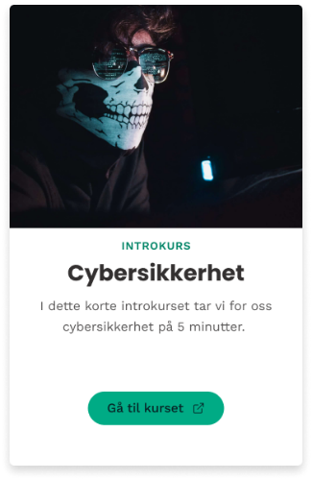
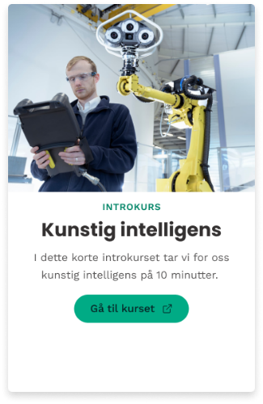
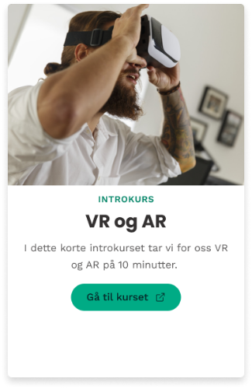
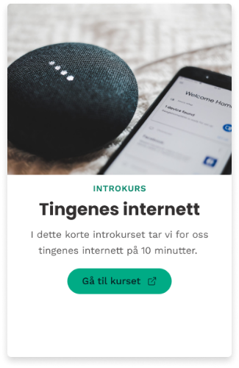
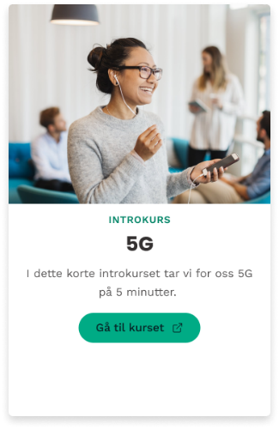
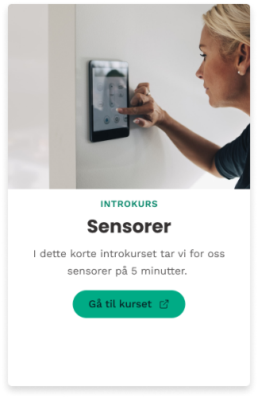
BUILDING AWARENESS
STEP 1 - EXAMPLE
CYBERSECURITY
ARTIFICIAL INTELLIGENCE
VR AND AR
I have taken the opportunity to learn more about cloud services and cybersecurity. The courses are easily accessible and are an effective way to learn something new about interesting and exciting areas.
- Leader of Salaries and agreements, SME.
INTERNET OF THINGS
SENSORS

Slide 10
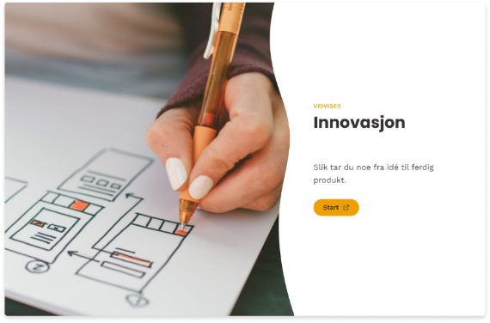
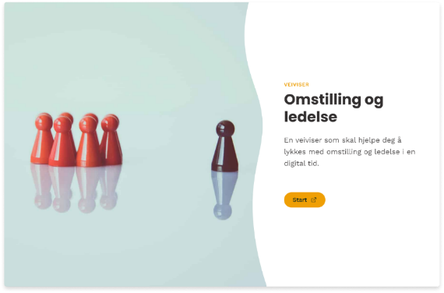
PRACTICAL TOOLS AND GUIDELINES
STEP 2 - EXAMPLE
CREATING VALUE FROM DATA
INCREASE IMMEDIATE VALUE
The course gave us good insight and hands-on experience using practical tools on which strategic assessments and processes the company should go through to succeed with our digitalization strategy!
We tend to focus on our own industry without reflecting on the need we may have from the expertise available in other industries. (...) The help we received and the discussions with peers were invaluable.
- Participants in informal educational workshops
INNOVATION
INCREASE INVOLVEMENT, SHARING AND REFLECTIONS
TRANSFORMATION & LEADERSHIP

Slide 11
IN-DEPTH
STEP 3 - EXAMPLE
DIGITAL TRANSFORMATION
CUSTOMER FOCUS
DATA & DIGITAL TECHNOLOGIES
LEADERSHIP AND CULTURE
PRACTICAL TOOLS AND GUIDELINES
ECOSYSTEM
INNOVATION
INCREASE INDIVIDUAL CAPABILITY OF POSITION NEW KNOWLEDGE INTO PERSONAL AND BUSINESS GOALS
The program has helped me to put several situations into a digitalization perspective, and I have used several of the tools to a great extent in collaboration with colleagues and partners. I feel a better sense of security in my own ability in meetings with customers and partners, and in that sense also a better ability to adapt to different situations and requirements. - Participants in formal continuous learning program
Key topics in continues education offered to SME-leaders

Slide 12
WRAPPING UP
Focus on pedagogical and didactical designs that provide immediate value to personal- and business value.
M Make sure that upskilling/reskilling is inherently combined with long term developed domain knowledge and experience.
Make room for flexibility, and avoid professional terminology in introduction learning resources
1
2
3

